Slide 1
New hardware and software technologies for real-time control in nuclear fusion experiments.
Marco Gottardo

Slide 2
The RFX consortium

Slide 3
R5 Machine Room

Slide 4
let's look back to 1991

Slide 5
let's look back to 1991
Marco Gottardo
SamuelePoppi

Slide 6
What were we doing?
installation of a high number of signal cables between the machine and the cublicles in the R4 diagnostic room adiacent to machine room. (useful work for prof. Zilli).
installation of a high number of optical fibers to bring the trigger to all the diagnostics in R4. (work supervisor dott. Volker Schmidt)

Slide 7
Data lines coming in R4 through the wall

Slide 8
R4 diagnostic room

Slide 9
R4 diagnostic room

Slide 10
R4 diagnostic room. Cubicles

Slide 11
R4 signal cables and fiber optics

Slide 12
instrumentation for diagnostics

Slide 13
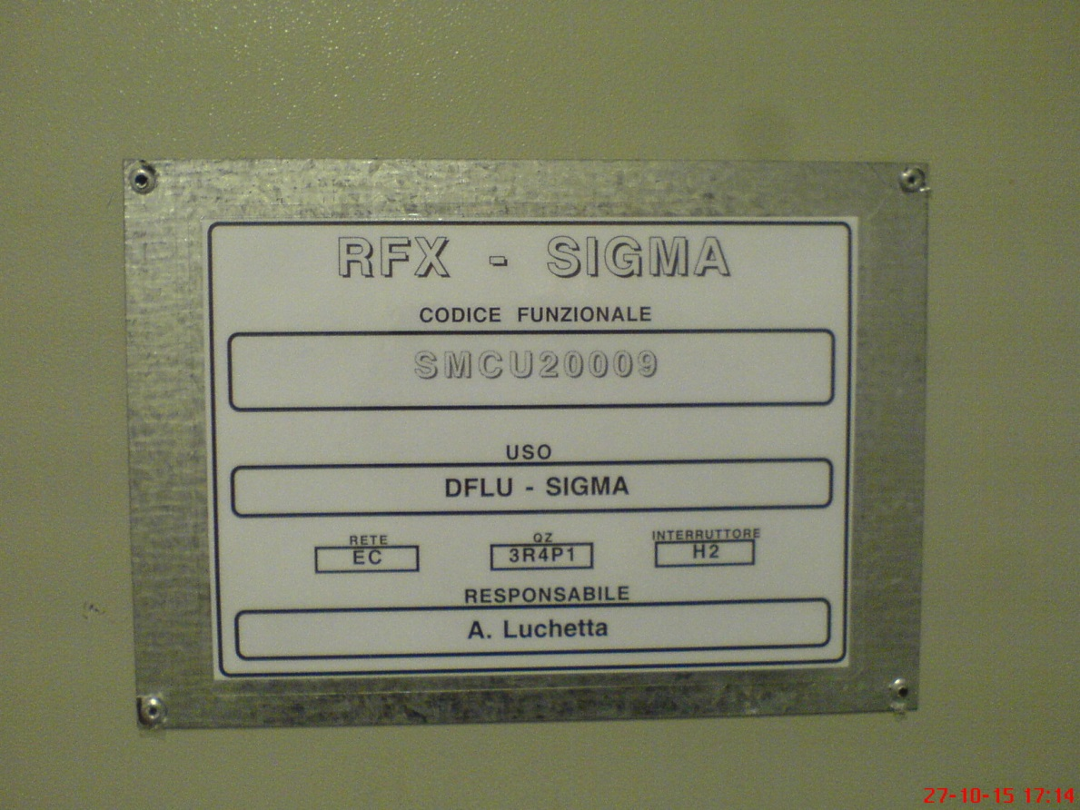
diagnostic cabinet

Slide 14
Current diagnostic system
In the cubliches on R4, adjacent to the R5, they are installed old designed RACK, called CAMAC crate.
in the CAMAC slots are mounted cards based on FPGA technology.
Each acquisition board is provided with two separate high speed analog channels. That is synchronized to the experiment via two TTL signals, the clock and the trigger transmitted in fiber optic.

Slide 15
CAMAC crate

Slide 16
pulse phases
The RFX-mod experiment of plasma magnetic confinement located in the Ionized Gas Institute of the National Research Council of Padua is of impulsive nature.
The diagnostics connected to the toroidal device are involved by following the steps listed below:
PRE
INI
PON
PRI/SEC

Slide 17
Pulse phases

Slide 18
Why the pulse required 4 stages?
These are necessary from the fact that the experiment has a high number of diagnostics connected to the RFP machine and located in a room adiacent to R5.
The torus is located in R5, from which start an intricate network of signals that pass through an hole in the wall to reach the cabinets in the room R4.
All diagnostics are setup from the control room where pulse is prepared according to the four steps listed.

Slide 19
PRE phase
This phrase has a duration not predetermined because it depends on the number of instruments involved in the experiment.
Typically the time required is 3 to 15 minutes.
The computer terminals, in the control Room, are connected to the MDSplus system who perform the preparation and synchronization of the all instruments.

Slide 20
INI phase
about a minute before the pulse signal is sent to all tools that have responded positively to do initialization.
This signal is called ARM and puts them on waiting the trigger signal.
Received this they will begin data acquisition.

Slide 21
PON phase
PON is the abbreviation for Pulse ON. It is the phase in which the trigger signal enables data acquisition.

Slide 22
Pri/SEC phase
(PRI=primary e SEC=secondary) ,
this is the stage in which the instruments return or rework data. There are two phases because the tools are of two types. Tool slow. fast tool.
Typically is the mass of data to process that terminates the response time.
To be put in the tree of traverse the data must be delivered by software tools called dispatcher. This occurs through the phase called store.

Slide 23
MDSPlus concept.
It is a non-relational database but hierarchical accessible by authorized research groups inside or outside the institution in which the experiment takes place.
It generates a tree whose nodes are impulses.

Slide 24
MDSPlus tree in RFX.
Per l’esperimento RFX MDSPlus genera due alberi.
RFX (historic all pulses)
RFX-run (Data stored h24 with technical measures, the baking, etc.).

Slide 25
MDSPlus
It prepares the system for reception and storage of data initially creating a new node. This is done by taking a form prepared with node number of -1, which functions as a template, to which is referred to by the name of model.

Slide 26
The -1 model on MDS Plus
Il model -1, insert the parameters of the experiment I want to parameterize or execute, in essence a new pulse.
Is the staff in the control room that assigns the number to the current shot.

Slide 27
New pulse (Control room)
In RFX, to perform a new impetus must be present in the control room 4 figures, who play the roles of :
C.S. scientific coordinator
S.L. scientific leader
R.T. technical manager (responsabile tecnico)

Slide 28
New pulse (Control room)
Si avviano le tre fasi di predisposizione, a tutti gli effetti i parametri impostati nel template -1 verranno passati all’impulso reale che sta per essere eseguito:
Clock mode -> It must be indicated whether internal or external, in the case of internal must indicate the sampling frequency (frequecy sample).
Trigger mode: Set as external. It can set as software mode.
Number of sample that defines how many samples will be acquired and subsequently stored in the MDSPlus tree pulse.

Slide 29
acquired data
The data may be queried / viewed via the traverse, and jscope, having the appearance of graphs can show a high number of curves simultaneously.
The main communication protocol is the Ethernet, which enables the insertion of cards Redpitaya as device acquisition.

Slide 30
What is an FPGA?
FPGA (Field Programmable Gate Array)
It is a tecnology which can allows parallel calculations in real time customizing the internal architetture by VHDL program.
The main topic of my research program consists in developing a new general purpose struments to install directly on the machine.
In particular the developments of this tool will start from the managements of the asynchronous events in a new configuration for fast ADC .

Slide 31
What is an FPGA?
The Field Programmable Gate Array are composed of three elements.
logic cells
I/O cell
Interconnection cells.
There are in addition groups of internal RAM.

Slide 32
FPGA: The logic cell Logic cell whit 4 input Look up table

Slide 33
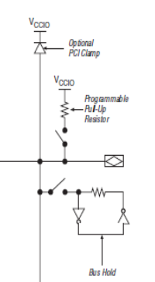
FPGA: The I/O cell

Slide 34
FPGA: Interconnection cells

Slide 35
FPGA: Chip concept

Slide 36
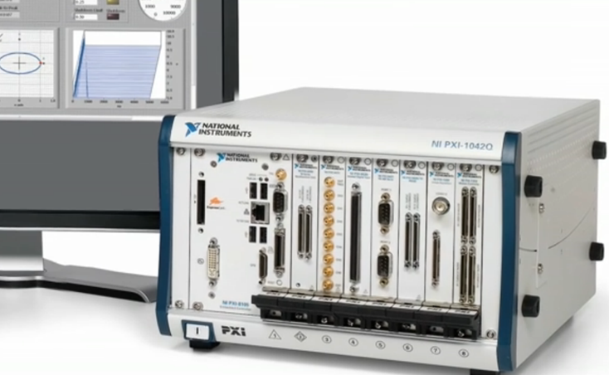
First ways of realization.
FPGA programming based on PXI.

Slide 37
Labview FPGA program for PXI

Slide 38
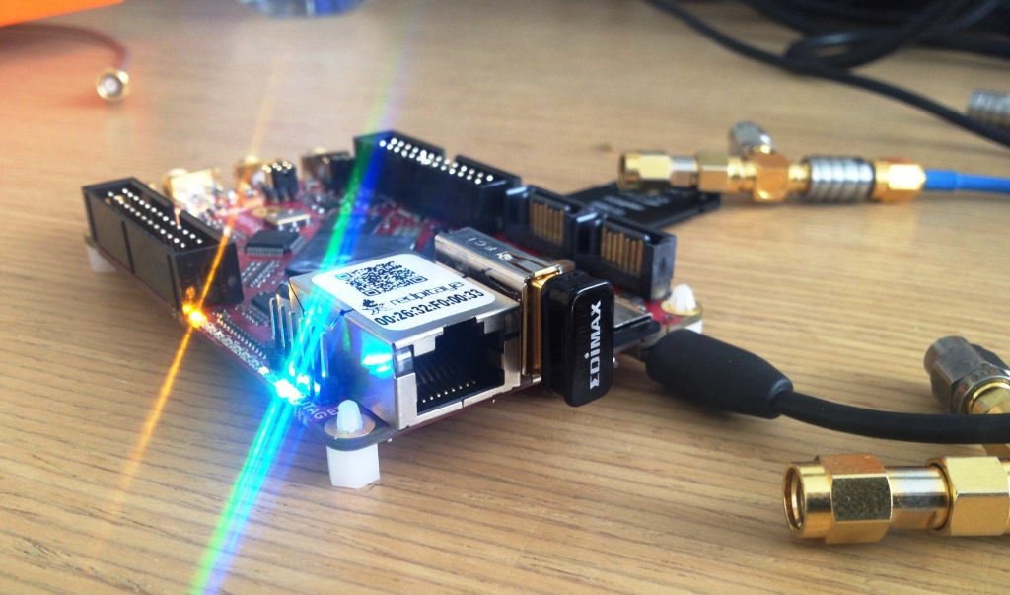
Second ways of realization.
FPGA programming based on RedPitaya.

Slide 39
Second way permit of...
Using WiFi capabilities a lot of tools can be monted directly on the machine.
Drastically reduce the length of the signal cables.
Reduce noise induced in the cables.
Reduce the number and size of the cabinets for diagnostic in R4.

Slide 40
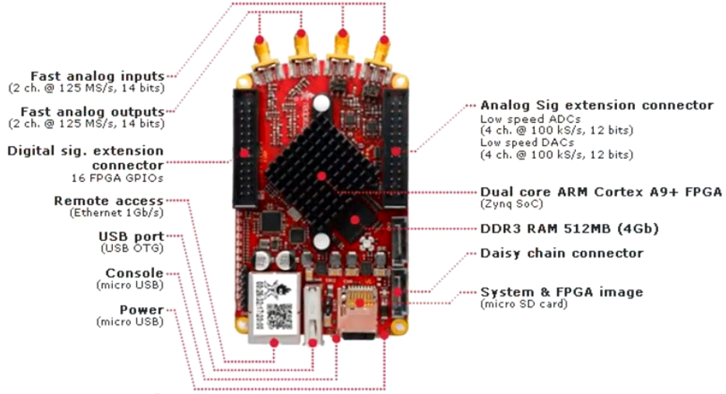
Redpitaya Layout and connector

Slide 41
Redpitaya: WiFi or Ethernet connection

Slide 42
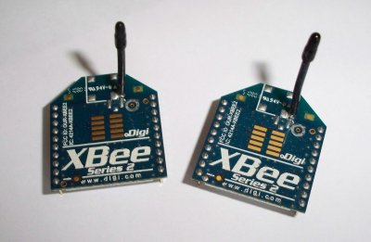
Possible interface
Xbee to create a grid of intelligent sensor
Normal Ethernet operation on LAN

Slide 43
Redpitaya functional blocks

Slide 44
Interfaccia WEB

Slide 45
Micro-GT mini 2
It is generating a sequence of 8 pulses of the duration of 20us each.

Slide 46
TTL trigger interface

Slide 47
Pulse sequence
start
parameters setting
acquisition sequence
Data access
Stop

Slide 48
Pulse sequence
start
parameters setting
jTraverse
acquisition sequence
Data access
Stop

Slide 49
Pulse sequence
start
parameters setting
jTraverse
acquisition sequence
mdstcl
Data access
Stop

Slide 50
Pulse sequence
start
parameters setting
jTraverse
acquisition sequence
mdstcl
Data access
jScope
Stop

Slide 51
Parameters setting New experiment node
Usando il Jtraverser creiamo il nuovo nodo ed impostiamo i parametri nel pannello dello strumento virtuale.
At the Linux prompt:
[gottardo@ra22]$ jTraverser
And create a new experiment called ‘Test’ with the shot number -1

Slide 52
Parameters setting New experiment node

Slide 53
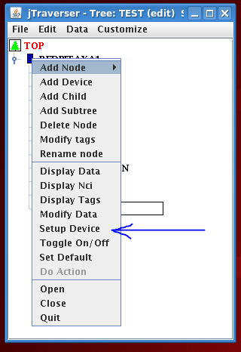
Setup virtual device

Slide 54
New virtual panel

Slide 55
MDSPlus TCL

Slide 56
acquisition sequence
$ mdstcl
TCL > set tree test
TCL >crea pulse 2
TCL >set tree/shot=2
TCL >do/method redpitaya1 init
------------------------------------------------------------
(system setup all of the diagnostic instrumentation.)

Slide 57
Init diagnostic

Slide 58
(the system is waiting for the trigger)
On the control room, the scientific leader call:
Start pulse sequence number ’35000’……
five ... four ... three ... two .. one.. zero
pulse !!!

Slide 59
Press trigger button

Slide 60
Of course the interface is arranged to obtain a remotely trigger .
connect the trigger here

Slide 61
Store sequence
TCL > do /method \store
TCL > close
--------------------------------------------------------------
The data were stored in the traverser
Its will be available to every research group

Slide 62
Jscope: New panel just type ‘jScope’ at the prompt

Slide 63
The scope need a configuration one error result just making drag and drop

Slide 64
How to configure the jScope? First:selec the server

Slide 65
How to configure the jScope? second:customize it act on Global settings

Slide 66
How to configure the jScope? third:indicate the esperiment session and shot number

Slide 67
Jscope show the stored data acquire by RedPitaya new application.

Slide 68
FPGA Altera

Slide 69
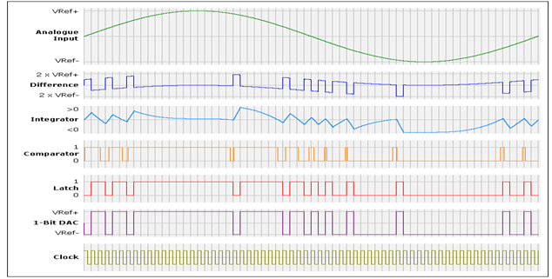
What i’m going to do?

Slide 70
Grazie per l’attenzione.
Marco Gottardo

